Slide 1

Loops / Iterators
Dr. M. Taimoor Khan
Asst. Professor
taimoor.khan@nu.edu.pk

Slide 2
Loops
3 Types of loops in C++
while
Most flexible
No "restrictions"
do-while
Always executes loop body at least once
for
Natural "counting" loop

Slide 3
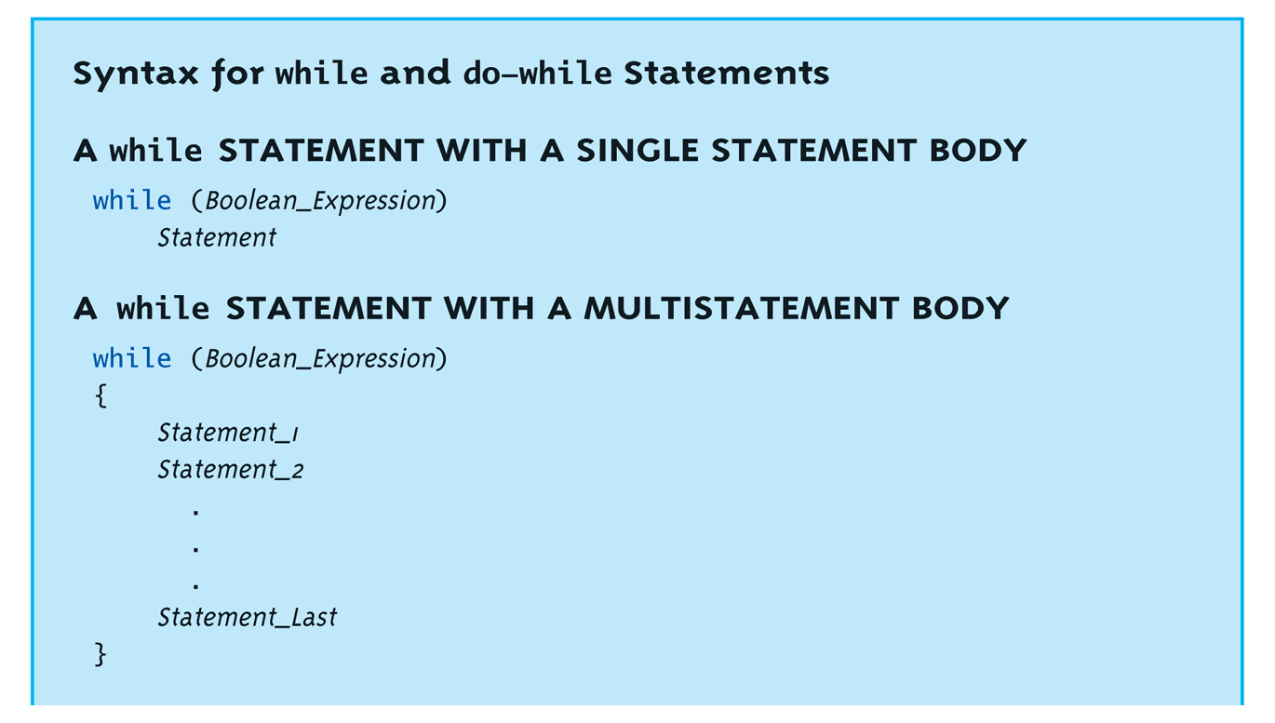
while Loops Syntax: Display, page 69

Slide 4
while Loop Example
Consider: count = 0; // Initialization while (count < 3) // Loop Condition { cout << "Hi "; // Loop Body count++; // Update expression }
Loop body executes how many times?

Slide 5
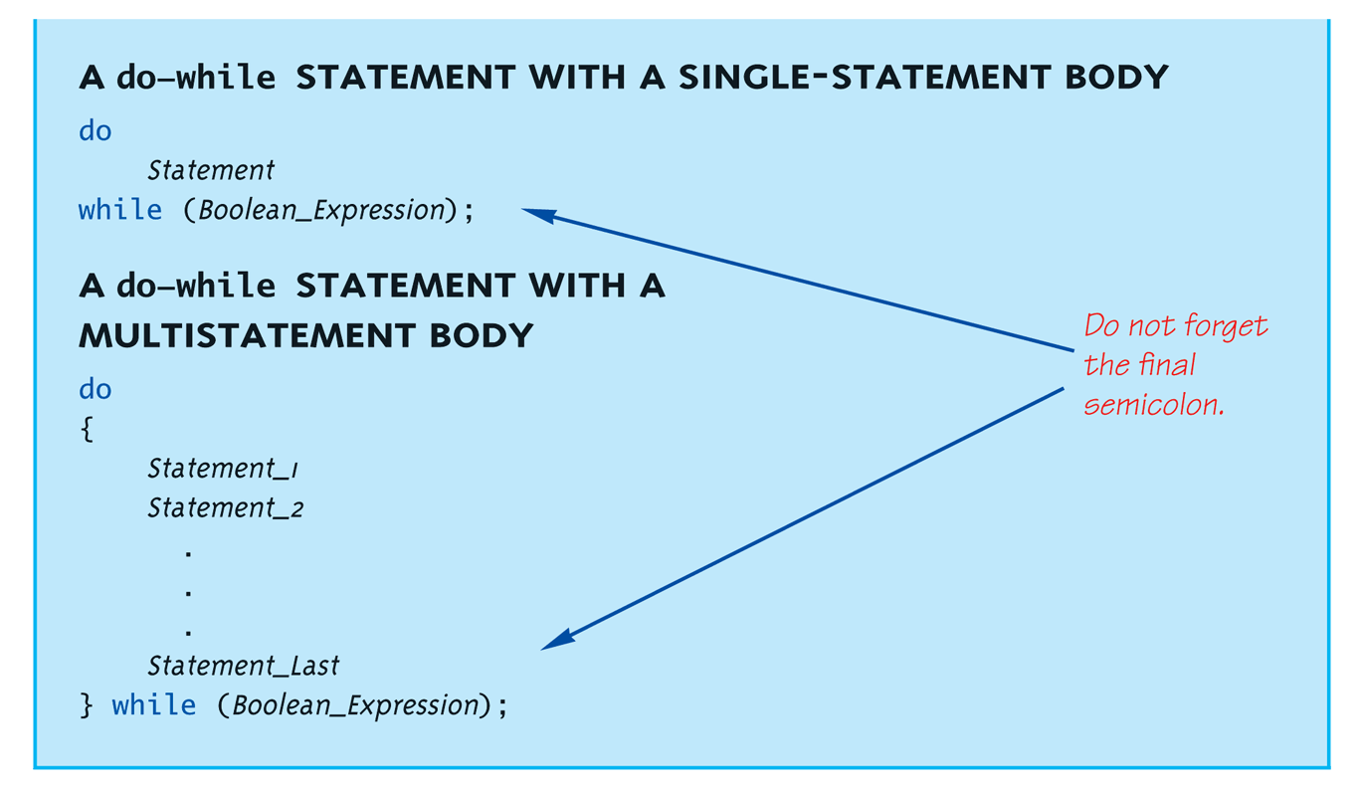
do-while Loop Syntax: Display, page 70

Slide 6
do-while Loop Example
count = 0; // Initialization do { cout << "Hi "; // Loop Body count++; // Update expression } while (count < 3); // Loop Condition
Loop body executes how many times?
do-while loops always execute body at least once!

Slide 7
while vs. do-while
Very similar, but…
One important difference
Issue is "WHEN" boolean expression is checked
while: checks BEFORE body is executed
do-while: checked AFTER body is executed
After this difference, they’re essentially identical!

Slide 8
for Loop Syntax
for (Init_Action; Bool_Exp; Update_Action)
Body_Statement
Like if-else, Body_Statement can be a block statement
Much more typical

Slide 9
for Loop Example
for (count=0;count<3;count++) { cout << "Hi "; // Loop Body }
How many times does loop body execute?
Initialization, loop condition and update all "built into" the for-loop structure!
A natural "counting" loop

Slide 10
Loop Issues
Loop’s condition expression can be ANY boolean expression
Examples:
while (count<3 && done!=0) { // Do something }
for (index=0;index<10 && entry!=-99) { // Do something }

Slide 11
Loop Pitfalls: Misplaced ;
Watch the misplaced ; (semicolon)
Example: while (response != 0) ;← { cout << "Enter val: "; cin >> response; }
Notice the ";" after the while condition!
Result here: INFINITE LOOP!

Slide 12
Loop Pitfalls: Infinite Loops
Loop condition must evaluate to false at some iteration through loop
If not → infinite loop.
Example: while (1) { cout << "Hello "; }
A perfectly legal C++ loop → always infinite!
Infinite loops can be desirable
e.g., "Embedded Systems"

Slide 13
The break and continue Statements
Flow of Control
Recall how loops provide "graceful" and clear flow of control in and out
In RARE instances, can alter natural flow
break;
Forces loop to exit immediately.
continue;
Skips rest of loop body
These statements violate natural flow
Only used when absolutely necessary!

Slide 14
Nested Loops
Recall: ANY valid C++ statements can be inside body of loop
This includes additional loop statements!
Called "nested loops"
Requires careful indenting: for (outer=0; outer<5; outer++) for (inner=7; inner>2; inner--) cout << outer << inner;
Notice no { } since each body is one statement
Good style dictates we use { } anyway

